Slide 1
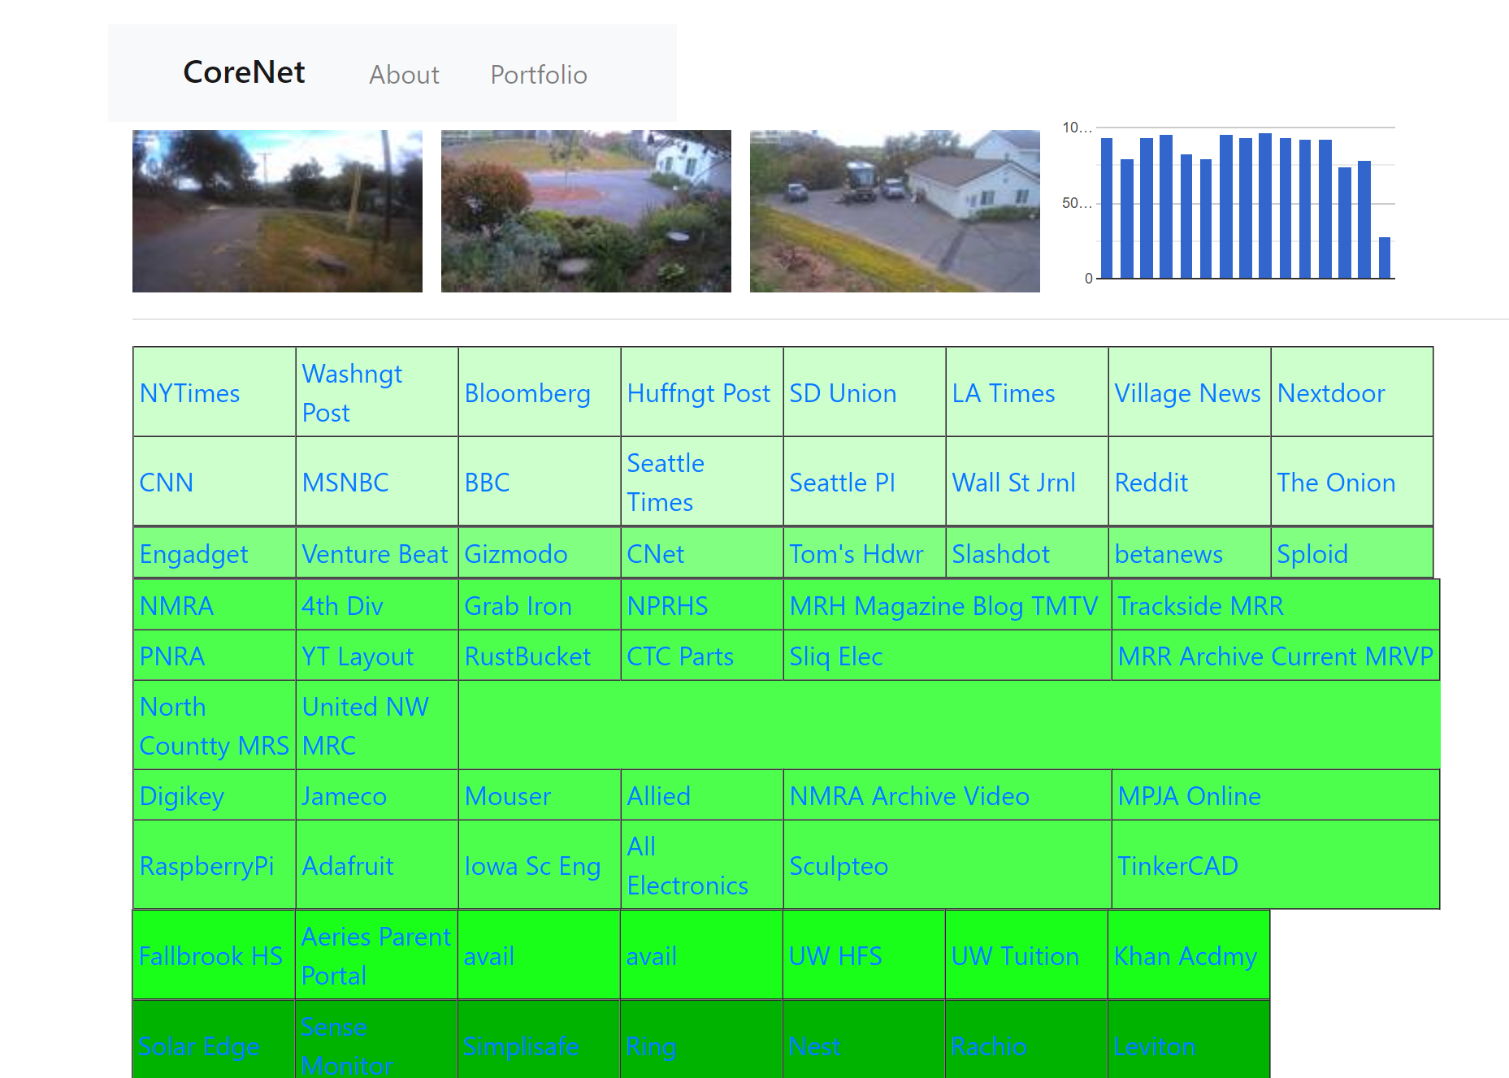
Project “Dasher”
Create a home page for your life – aggregator of the multiple web activities in your day
  your most frequented web destinations
  At-a-glance status on various home IOT devices (stills from webcams, solar production, etc);
  Organize by category
  Present in pleasing themes
  Different types of data:
    Web cam pictures
    RSS feeds
    Static Links
    Reach for v1 : interface to home IOT devices
  Secure and strong authentication
Integrate External Data sources
  RSS news feed support
  Weather
  Emergency info – e.g. during fire season
  Headlines pulled from NYTimes, local news sources
  Public camera snapshot URLs
Integrate Home IOT devices information (stretch goals)
  Home web cameras snapshots
  Solar generation / generation prediction graph
  Visitor Log (via ring doorbell etc)
  Lighting status
  Irrigation data, trends
  Monitoring of gates/garage door open/close via GPIO
  Electricity usage, rates, optimal charging times
  Notifications to user via email/SMS

Slide 2
Minimum Viable Product
Public URL for images
RSS / CNN feeds
Page layout
Authentication
Static links
Stretch
PW reset/email
MSQL/local fil storage of images
Refined layout / drag and drop
Add door open/close door monitoring
Get running on Raspberry Pi

Slide 3
Website Implementation
Node.js app for configuring pages and serving the page
Home Page is provided to user to paste into brower’s home page
Configuration pages for :
  Adding new destinations and devices to the home page,
    store in mysql
  Email, SMS config
  Stretch config pages
    Email
    Wifi, Ethernet config – validate inputs, store in mysql
    External data source config, (URL, user/pw)
    External sensor configuration (GPIO)

Slide 4
Technologies
From coursework:
  MySQL, sequelize
    For storing user configs
    Node.js, Express, Bootstrap, Handlebars
New:
  RSS feeds
  Fetching Snapshots from public cameras
  Weather API
  GUI client for laying out home page
  Stretch Linux, bash programming, deployment to Raspberry Pi
  Stretch IOT device integration
  Stretch node mailer for event notification

